Slide 1

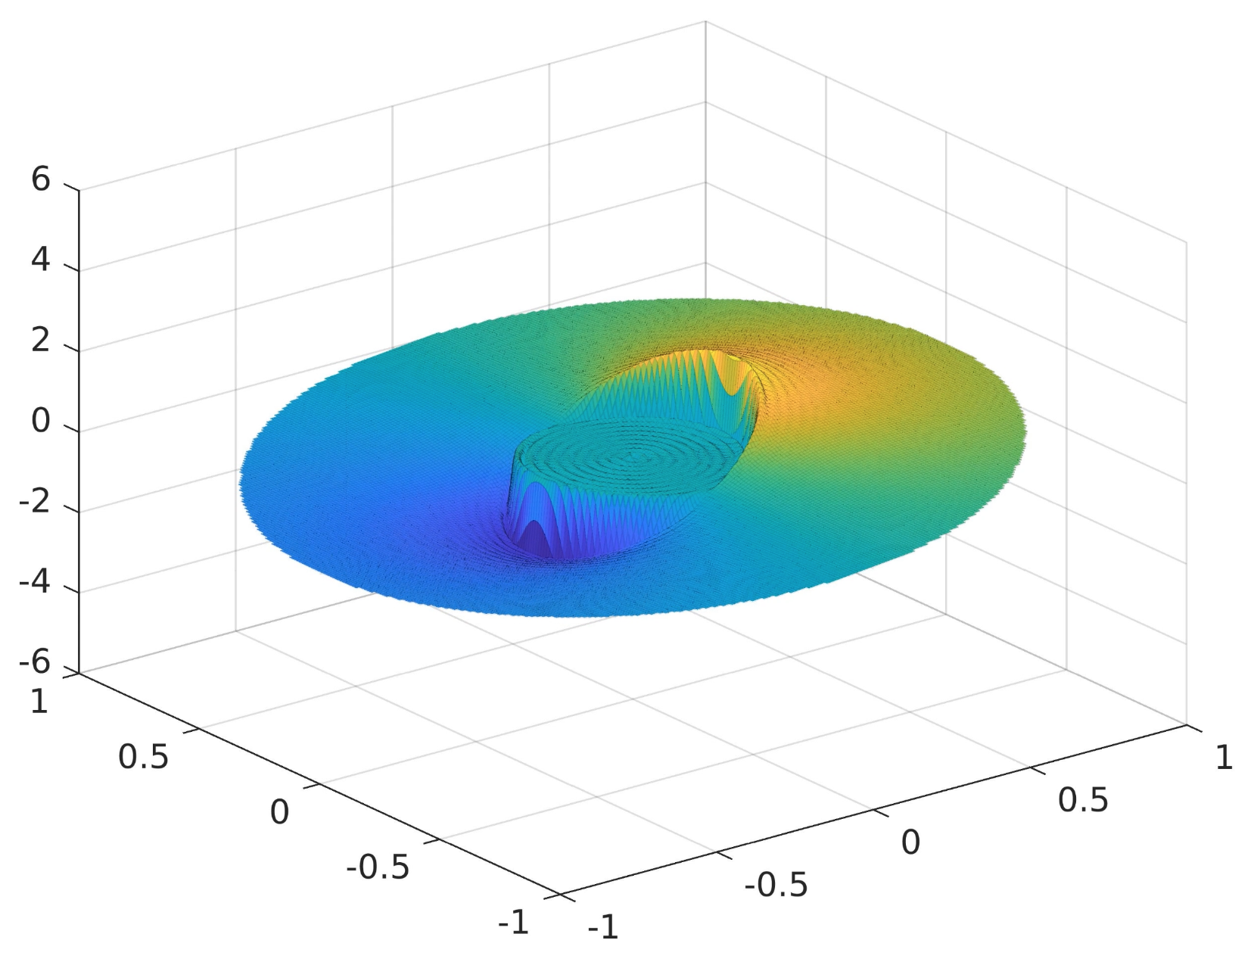

WAVE: Comparing Numerical Methods on Cylindrical Wave Equation Solver Performance
APC523 Final Project
Michael D. Walker (mw6136)
Philip Satterthwaite (ps1639)
Michael Schroeder (ms2774)
PhD Candidates
Mech. & Aero. Engineering
Kanagawa-oki Nami Ura. The Great Wave off Kanagawa.

Slide 2
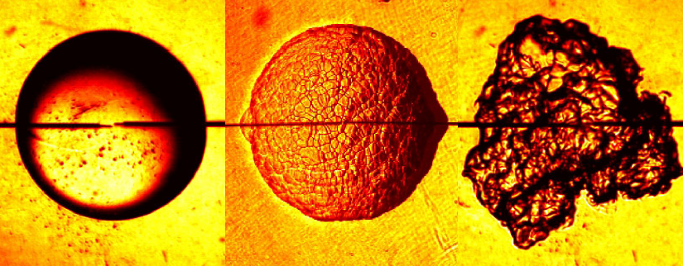
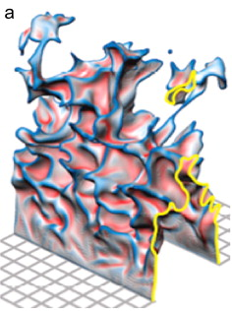
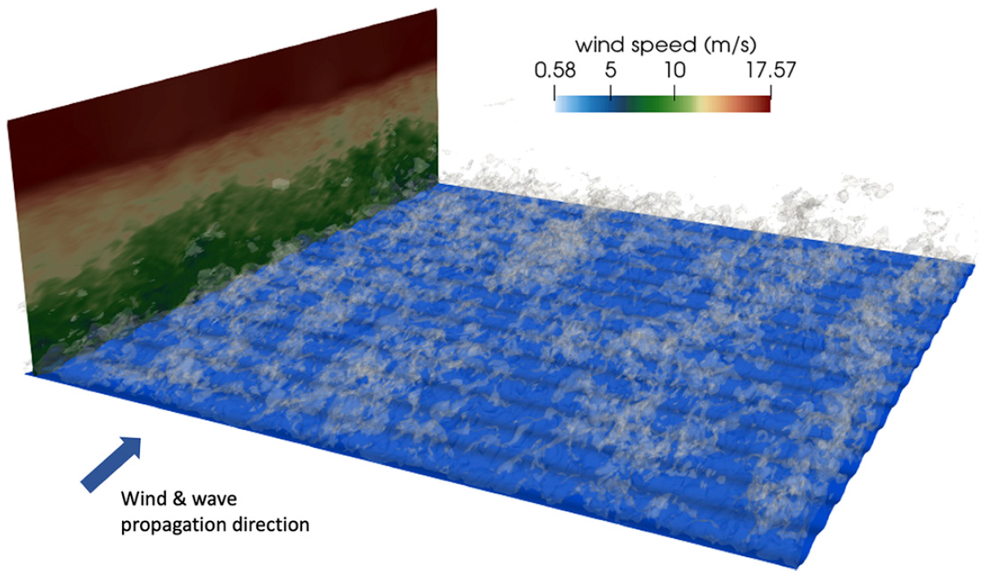
Motivation
The ability to understand and predict surface deformation is of great importance to a broad range of applications in fluid dynamics. Particular to our research (lab: CTRFL) are the ocean surface perturbed by wind, and combustion processes (modeled as an iso-surface of fast-reacting chemistry) perturbed by turbulence. Understanding these deformations requires solving high-order partial differential equations, a task that is often impossible to do mathematically and must be done numerically.
We seek to build a model of surface deformation by solving the scalar wave equation in cylindrical coordinates. Thereby resolving waves on the surface of a fluid generated by the motion of the walls. Further, we will investigate the trade-offs between speed, cost, accuracy, and stability of various numerical methods.
Law et al. Three faces of a flame.
Driscoll, J. F. Progr. Energy Combust. Sci., 2008.
Deskos et al. J. Atmos. Sci., 2021.

Slide 3
Contributions
Michael Walker (mw6136):
Developed the full analytical solution shown in the Appendices.
Created the FFT_solver using Spectral methods, and further developed improvements in speed and stability.
Contributed the relevant sections of the report, majority of background & conclusions, most of the presentation slides, and the README for documenting and running the code.
Philip Satterthwaite (ps1639):
Researched viability of time-stepping methods
Developed code for Forward Euler and RK2 methods
Contributed to relevant sections of the report and presentation
Michael Schroeder (ms2774):
Coded analytical solution
Created plots and exported data
Implemented, helped derive, and analyzed finite difference discretization method
Analyzed applicability of iterative methods to this problem
Contributed to relevant sections of the report and presentation

Slide 4
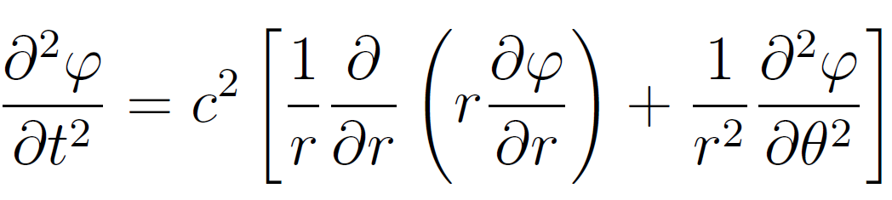
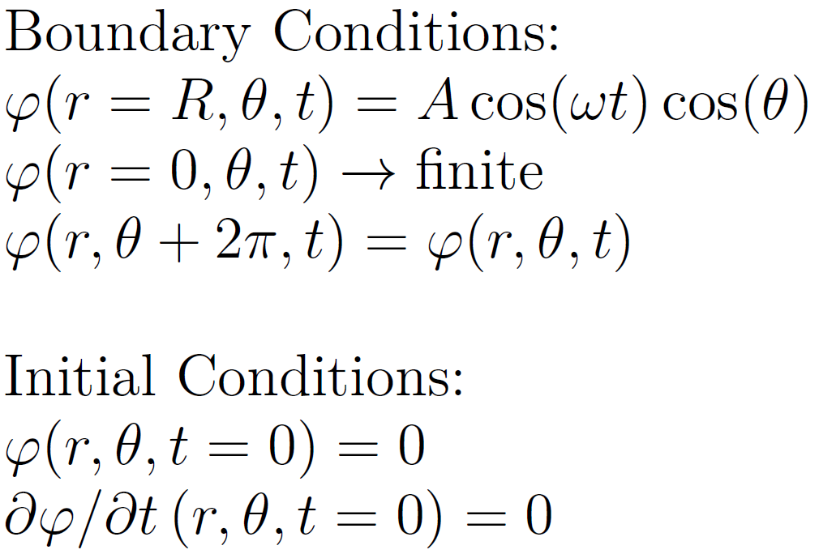
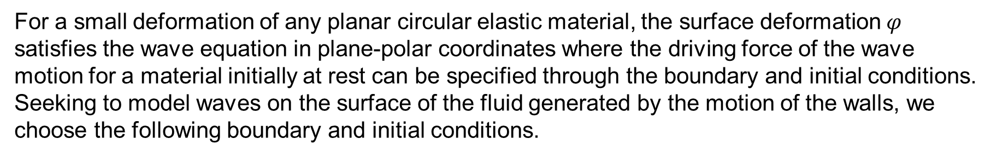
Problem Statement
For a small deformation of any planar circular elastic material, the surface deformation $φ$ satisfies the wave equation in plane-polar coordinates where the driving force of the wave motion for a material initially at rest can be specified through the boundary and initial conditions. Seeking to model waves on the surface of the fluid generated by the motion of the walls, we choose the following boundary and initial conditions.
Boundary Conditions:
Initial Conditions:
We will solve for $φ$ for all $t$, $θ$, and $r$ using the method of separation of variables and eigenfunction expansions, then use properties of orthogonality to solve for coefficients.
Problem Set 9, Exercise 3. MAE501: Mathematical Methods of Engineering Analysis I, Fall 2023.

Slide 5
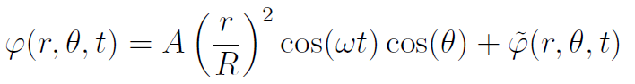
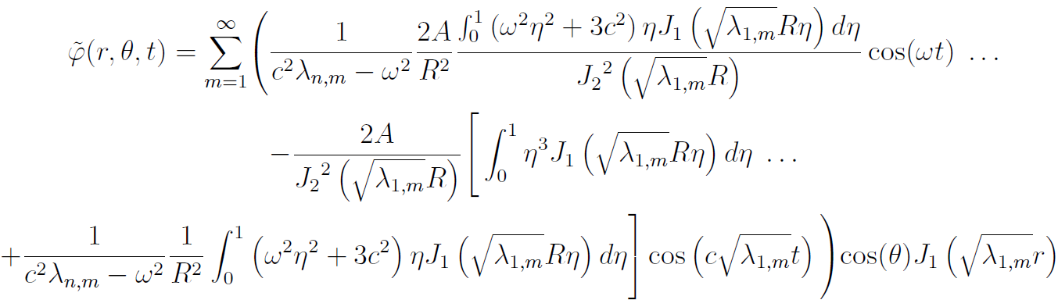
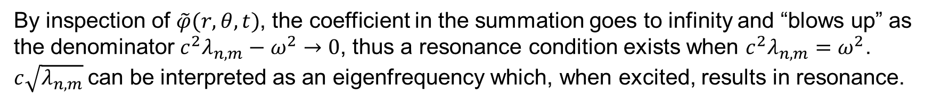
Analytical Solution
Separation of variables and eigenfunction expansion gives the final solution:
By inspection of $\tilde{φ}(r, θ, t)$, the coefficient in the summation goes to infinity and “blows up” as the denominator $c^{2}λ_{n,m}−ω^{2}→0$, thus a resonance condition exists when $c^{2}λ_{n,m}=ω^{2}$. $c\sqrt{λ_{n,m}}$can be interpreted as an eigenfrequency which, when excited, results in resonance.
See Appendix of project report for full derivation.

Slide 6
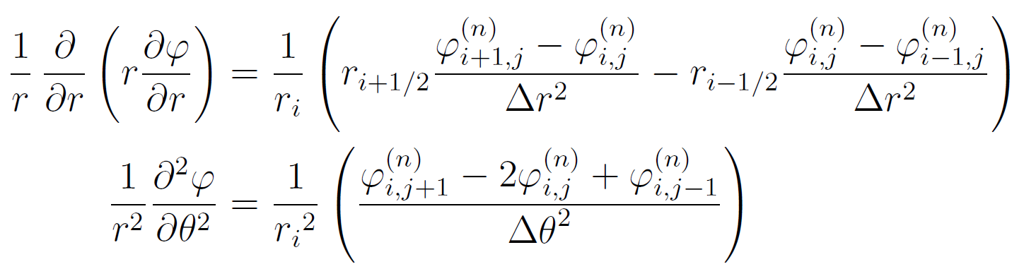
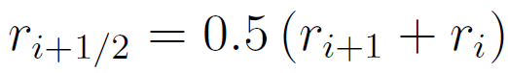
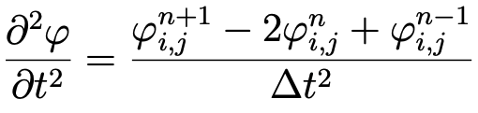
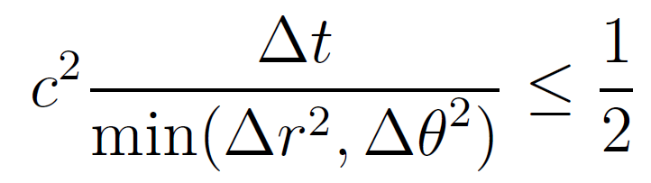
Discretization and Finite Difference
Define:
Using forward difference (explicit method) in $r$ and central differences in $θ$ and $t$
where
CFL condition:
K. Kanos. Discretizing the wave equation in polar coordinates, (2014).

Slide 7
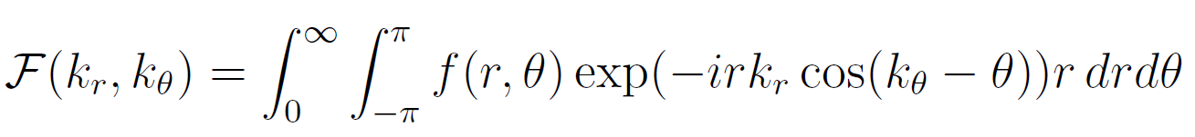
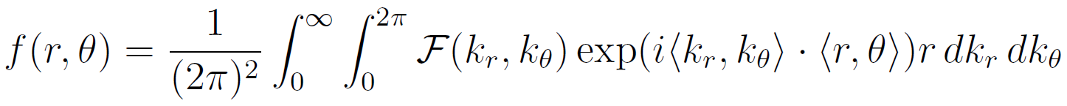
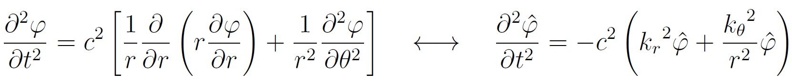
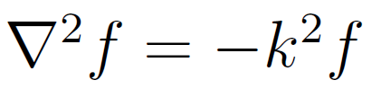
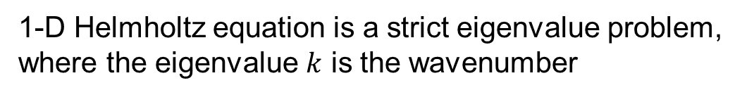
Fourier Spectral Methods
2-D Fourier Transform in polar coordinates and its inverse:
The Laplacian Fourier pair in polar coordinates:
Transform the scalar wave equation ($ℱ\left(φ\right)=\hat{φ}$) to obtain the Helmholtz equation with a time-forcing term:
1-D Helmholtz equation is a strict eigenvalue problem,
where the eigenvalue $k$ is the wavenumber
N. Baddour. Two-Dimensional Fourier Transforms in Polar Coordinates, (2011).

Slide 8
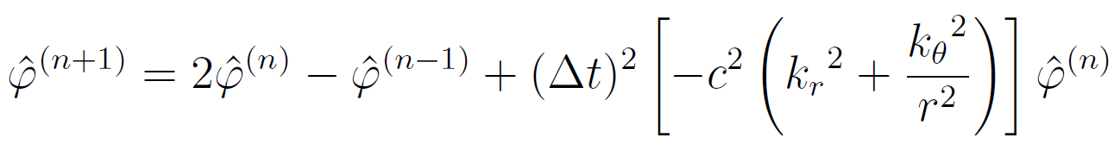
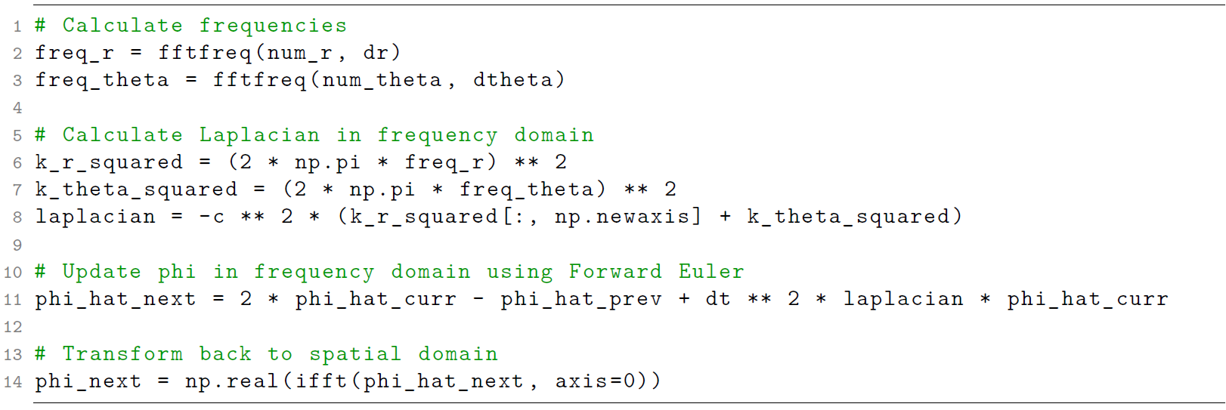
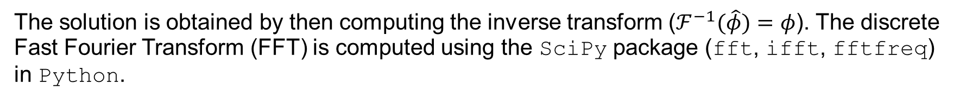
Fourier Spectral Methods (cont.)
Evolve the equation in time by choosing a simple Forward Euler iterative scheme:
The solution is obtained by then computing the inverse transform ($ℱ^{−1}(\hat{φ})=φ$). The discrete Fast Fourier Transform (FFT) is computed using the SciPy package (fft, ifft, fftfreq) in Python.
B. Costa. “Spectral Methods for Partial Differential Equations” CUBO, (2004).

Slide 9
Results

Slide 10
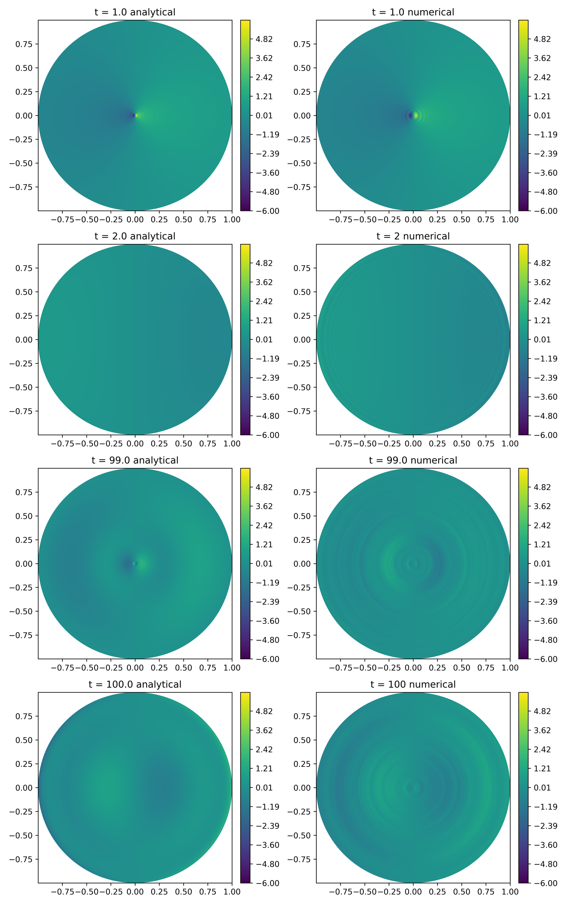
Finite Difference Discretization Method
Reasonably accurately captures analytical solution
Short runtimes
Stable
Numerical accuracy decreases with time

Slide 11
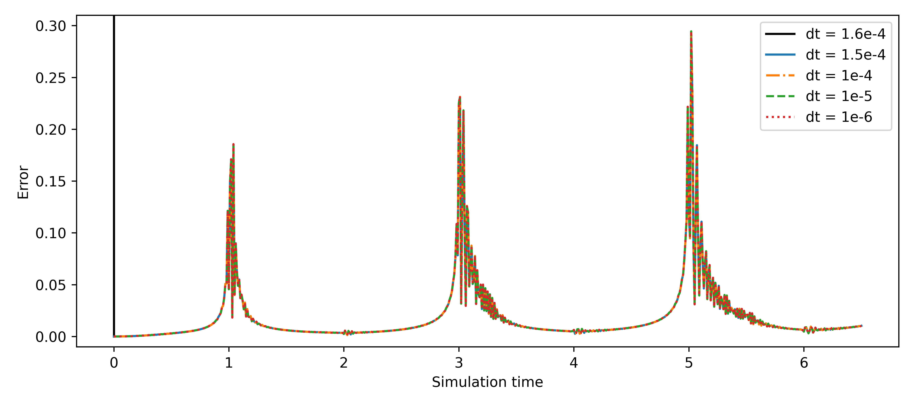
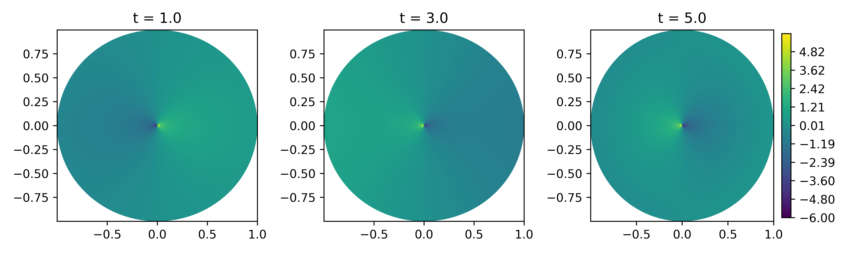
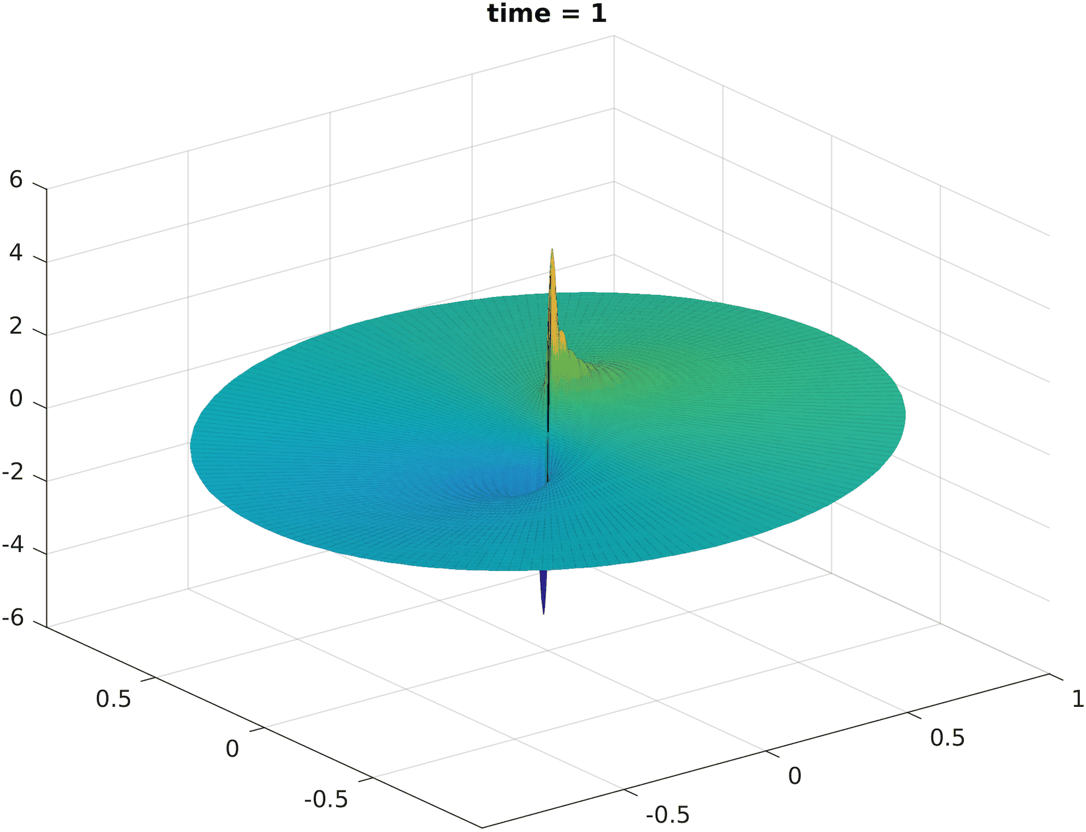
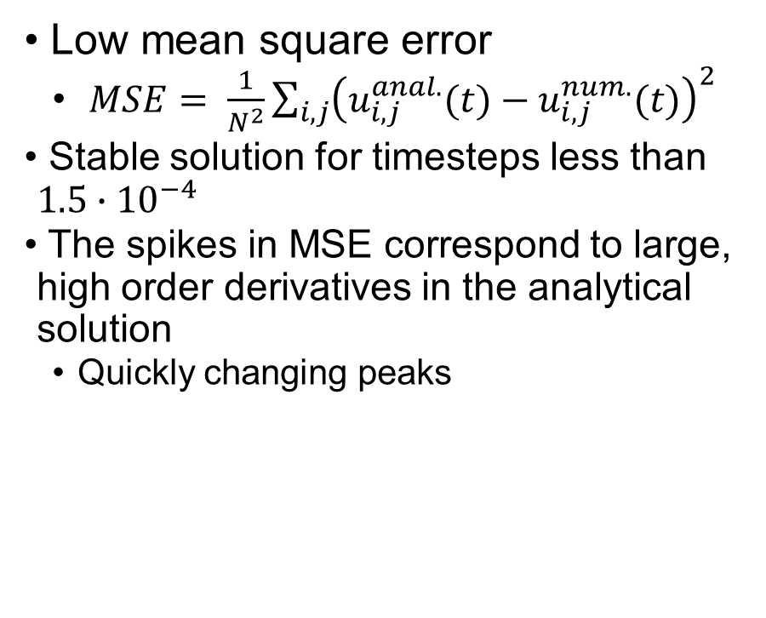
Finite Difference Discretization Method (cont.)
Mean Square Error vs. Time at Multiple Δts
Low mean square error
$MSE= \frac{1}{N^{2}}\sum_{i,j}{{\left(u_{i,j}^{anal.}(t)−u_{i,j}^{num.}(t)\right)}^{2}}$
Stable solution for timesteps less than $1.5∙{10}^{−4}$
The spikes in MSE correspond to large, high order derivatives in the analytical solution
Quickly changing peaks
Analytical Solution at Times Corresponding to MSE peaks

Slide 12
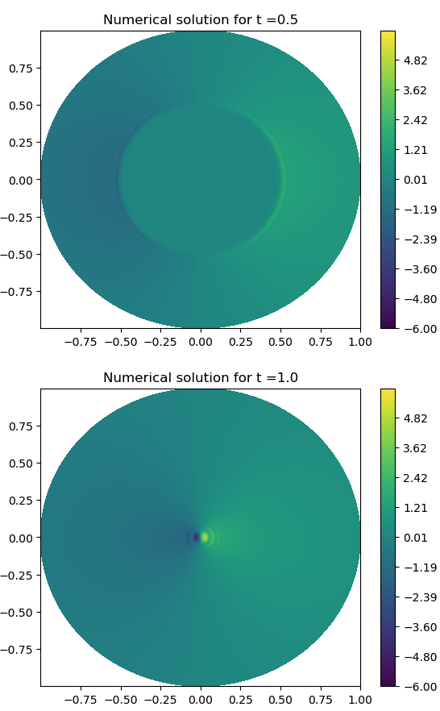
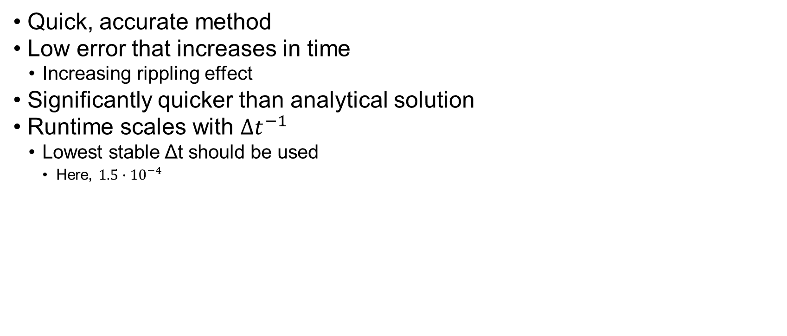
Finite Difference Discretization Summary
Quick, accurate method
Low error that increases in time
Increasing rippling effect
Significantly quicker than analytical solution
Runtime scales with $Δt^{−1}$
Lowest stable Δt should be used
Here, $1.5∙{10}^{−4}$

Slide 13
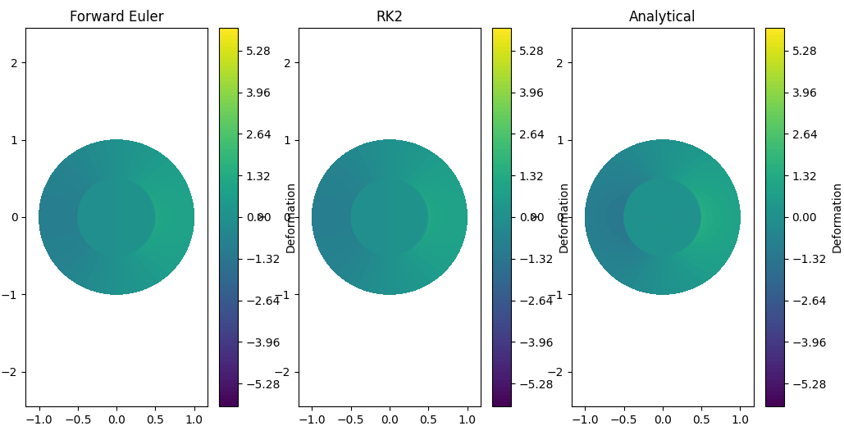
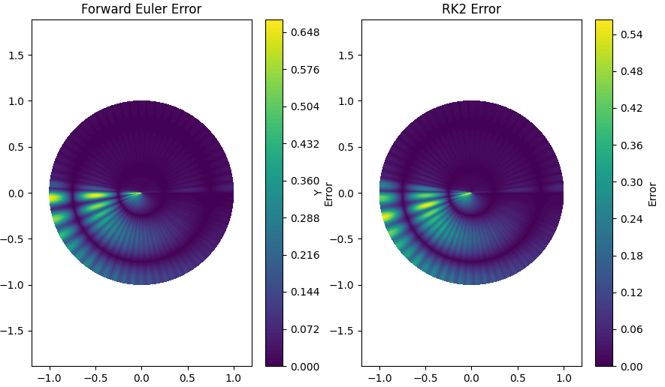
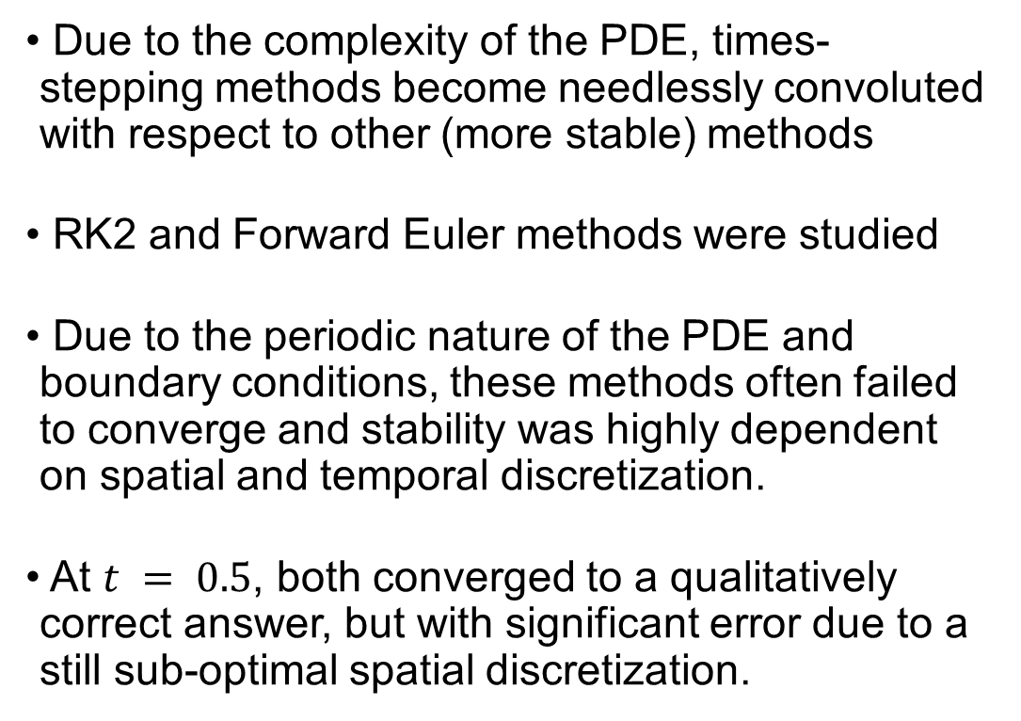
Time Stepping Methods
Due to the complexity of the PDE, times-stepping methods become needlessly convoluted with respect to other (more stable) methods
RK2 and Forward Euler methods were studied
Due to the periodic nature of the PDE and boundary conditions, these methods often failed to converge and stability was highly dependent on spatial and temporal discretization.
At $t = 0.5$, both converged to a qualitatively correct answer, but with significant error due to a still sub-optimal spatial discretization.

Slide 14
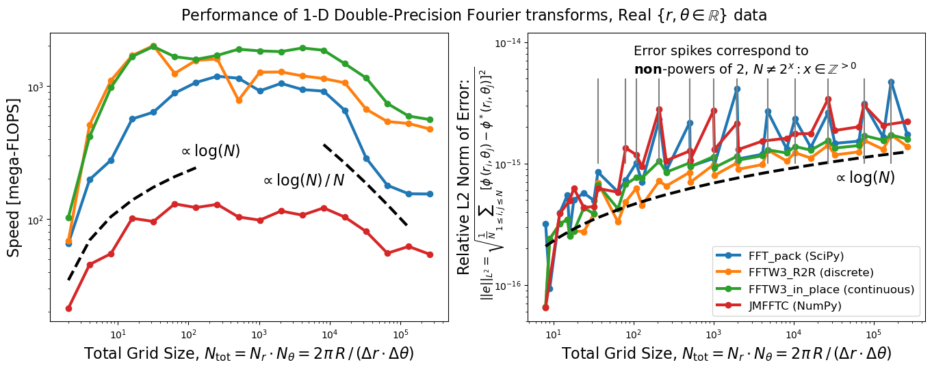
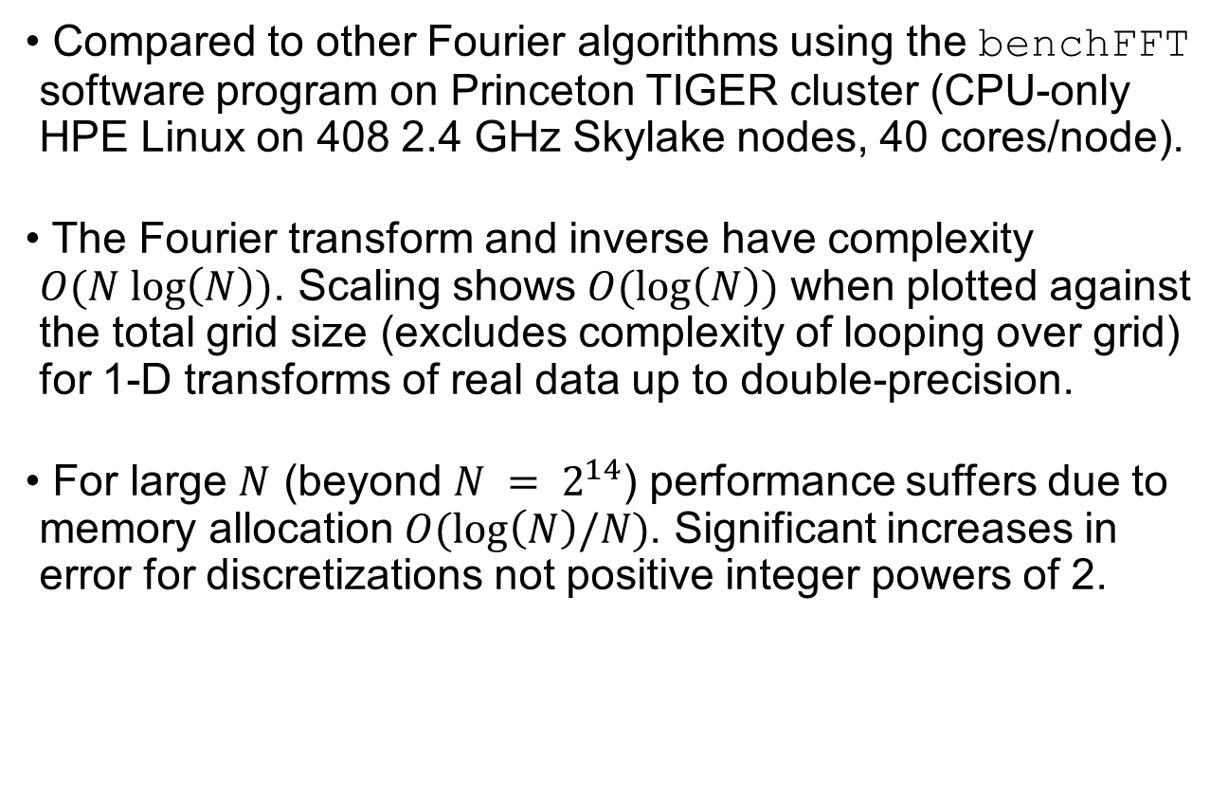
Fourier Spectral Methods
Compared to other Fourier algorithms using the benchFFT software program on Princeton TIGER cluster (CPU-only HPE Linux on 408 2.4 GHz Skylake nodes, 40 cores/node).
The Fourier transform and inverse have complexity $O(N log\left(N\right))$. Scaling shows $O(log\left(N\right))$ when plotted against the total grid size (excludes complexity of looping over grid) for 1-D transforms of real data up to double-precision.
For large $N$ (beyond $N = 2^{14}$) performance suffers due to memory allocation $O(log\left(N\right)/N)$. Significant increases in error for discretizations not positive integer powers of 2.

Slide 15
Performance Engineering
The accuracy of this numerical simulation is determined largely by the spatial resolution requirements. The timestep and numerical stability was therefore limited by this discretization and the speed of sound.
Performance was optimized by limiting the number of looping functions and using NumPy vectorization wherever possible.
Whenever major looping was required, Numba just-in-time compiler was used in “no Python mode”.

Slide 16
Future Work
Numerical Improvements: Speed (spatially varying timesteps, residual averaging), Accuracy (higher-order smoothing, higher-order differencing, differed correction factors), Stability (high-order expansions and second-order term in time derivative)
Now that the various numerical methods have been evaluated, this approach can be coupled to the G-equation, to provide a deterministic description of flame iso-surface perturbations in turbulent flows.
Implement parallelization using protocols like OpenMP and MPI.
Methods for more efficient mesh discretization (such as adaptive mesh refinement) were beyond the scope of this project, but could also be implemented to improve accuracy, particularly in the supersonic case.

Slide 17
Lessons Learned
Gained significant proficiency in virtually all numerical method topics of this course. While not relevant to this project, the course content in massively parallel architectures was also extremely relevant to our research.
Collaborate on writing code in a “linear” way when possible, such that merge conflicts are straightforward to resolve.
Ideas of testing and performance must be kept in mind from the beginning (test-driven development!)
We work in a computational group (the Computational Turbulent Reacting Flow Laboratory) and this course genuinely helped us understand the numerical methods implemented in our existing solvers, like NGA, PDRs, SUNDIALS, HYPRE, LAPACK, and FFTW, giving us more exposure to its syntax and code format that will be greatly useful to us in our future research.

Slide 18
Appendix: Analytical Solution

Slide 19
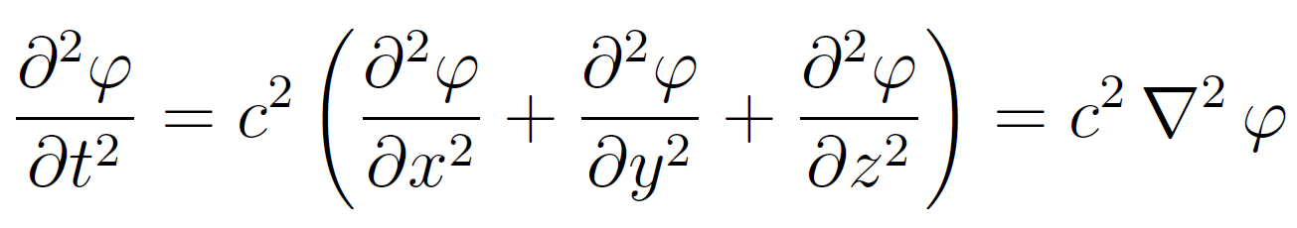
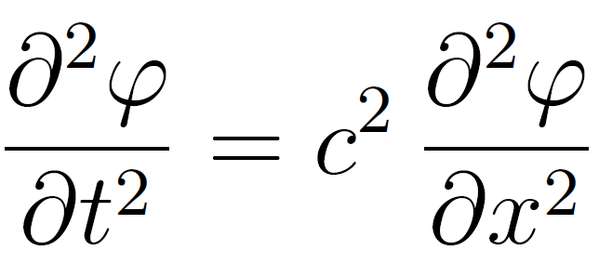
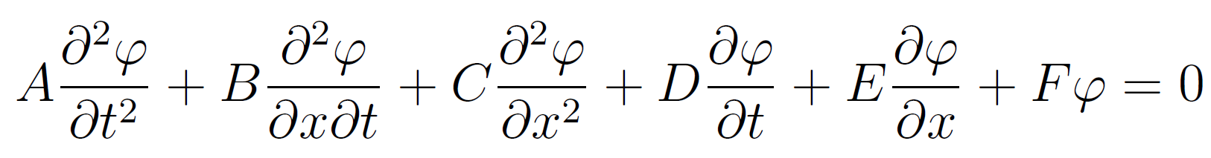
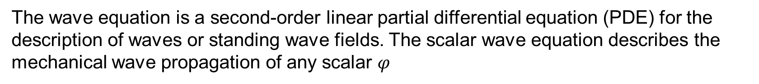
Wave Equation Classification
The wave equation is a second-order linear partial differential equation (PDE) for the description of waves or standing wave fields. The scalar wave equation describes the mechanical wave propagation of any scalar $φ$
1-D:
Projected in the 2nd order PDE general form gives $A = 1$, $B = 0$, and $C = −c^{2}$, and thus the discriminant $B^{2} − 4AC > 0$defines a hyperbolic PDE with a well-posed initial value problem.

Slide 20
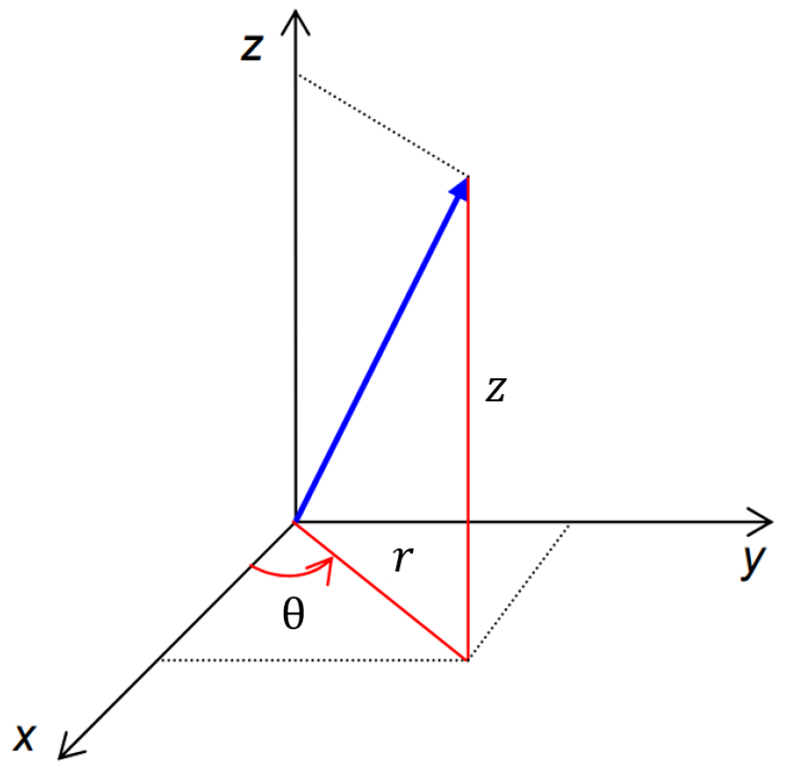
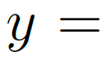
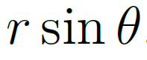
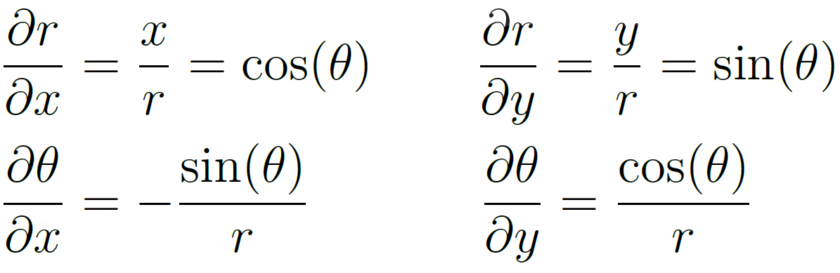
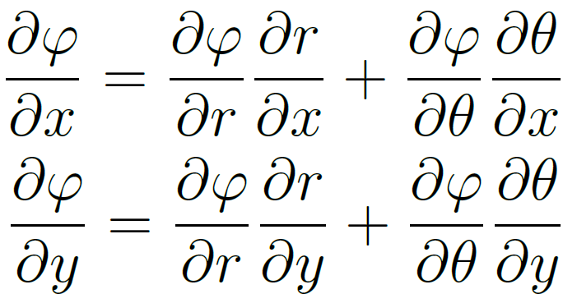
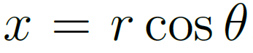
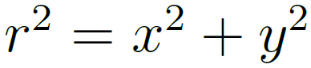
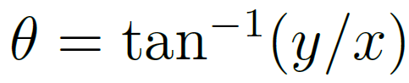
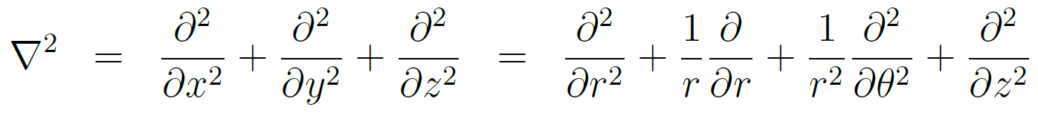
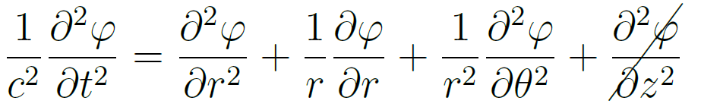
Cylindrical Wave Equation
For circularly propagating waves, it is useful to project the wave equation in cylindrical coordinates.
This remains a hyperbolic PDE, but with a singular point at the origin $r = 0$. The study of surface deformation requires only plane-polar coordinates, so the $∂^{2}φ/∂z^{2}$term may be neglected. We now seek an analytical solution to the 2-D equation, given well-posed boundary and initial conditions.

Slide 21
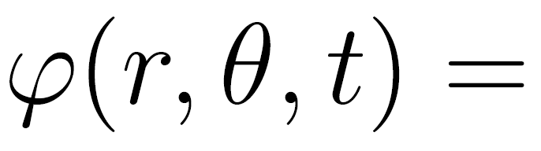
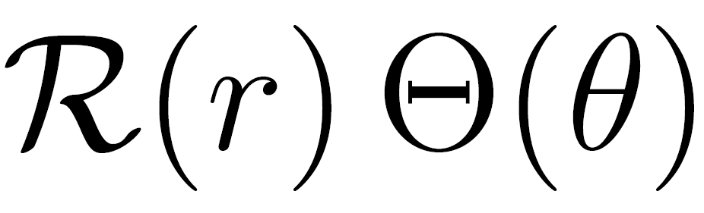






Analytical Solution
Separation of variables:
The Bessel Equation:
whose solution is the Bessel function:
See Appendix of project report for full derivation.

Slide 22





Analytical Solution (cont.)
Rescaling to achieve homogeneous boundary conditions:
Stationary Problem:
Eigenvalue expansion:
Solving for coefficients with orthogonality (inner product):
See Appendix of project report for full derivation.

Slide 23





Analytical Solution (cont.)
Expanding $\tilde{φ}$:
Solving for coefficients with orthogonality (inner product) and initial conditions:
See Appendix of project report for full derivation.

Slide 24
Analytical Solution (cont.)
Thus the final solution:
By inspection of $\tilde{φ}(r, θ, t)$, the coefficient in the summation goes to infinity and “blows up” as the denominator $c^{2}λ_{n,m}−ω^{2}→0$, thus a resonance condition exists when $c^{2}λ_{n,m}=ω^{2}$. $c\sqrt{λ_{n,m}}$can be interpreted as an eigenfrequency which, when excited, results in resonance.
See Appendix of project report for full derivation.

Slide 25



Fundamental Nodes
The whole solution is a linear combination of standing waves. The fundamental vibrations (left) are shown for radially derelict boundary conditions ($φ\left(r=R, θ, t\right)=0$). The nodal curves (right) show the set for points for which $φ\left(r, θ\right)=0 ∀t$, dividing the domain into nodal regions. Recall that that $λ_{n,m}$is the eigenmode for the $m$-th root of the $n$-th order Bessel function $J_{n}$ for $m=1, 2, 3, 4$.
Lecture Notes, Math 483/683: Partial Differential Equations. Spring 2023, NDSU.

